Slide 1
LED blink using bit banding concepts

Slide 2
Bit-Banding
Bit-banding is a hardware feature in the ARM Cortex-M4 that turns one individual memory bit into a full 32-bit word. It allows the processor to set, clear, or read a single bit in one atomic (uninterruptible) instruction. This prevents common data errors without needing to disable interrupts.
Usually, to change one bit, your code must perform a read-modify-write cycle:
  Read the whole byte/word from memory into the processor.
  Modify (change) only that one specific bit.
  Write the whole byte/word back to memory.
If an interrupt happens between the read and write steps, data can get corrupted.
Advantage: Changing the value of register’s bits using atomic operation (the READ-MODIFY-WRITE operation cannot be interrupted by other activities).
How Bit-Banding Solves This
The Cortex-M4 splits its memory into two areas:
  Bit-Band Region: The actual memory where your data and peripherals live.
  Alias Region: A separate, "fake" memory area. Every single bit in the Bit-Band region is mapped to a unique full word in the Alias region.
Think of it like a remote control. The "Bit-Band Region" is the ceiling light (hard to reach). The "Alias Region" is the wall switch. When you flip the switch (write to the alias address), it controls the light directly.

Slide 3
Bit banding lets you change a single bit of data in memory using a simple, one-step command. It maps a tiny bit into a large space, making it easy to access.
Normally, to change one bit, a computer must read the whole byte, change the bit, and write it back. If another task changes the same byte at the same time, data gets lost.
Bit banding does this in one safe, unskippable step. Imagine a traffic light. Instead of painting the entire traffic signal green, you just flip a single light switch to change the one light bulb.
For example, on an ARM processor, you can turn on a specific LED connected to pin 5. Instead of doing three complex math steps to find the pin, you simply write a 1 to a special "alias" memory address designed just for that single bit.

Slide 4
How to Calculate the Alias Address
To access a single bit, you do not touch the original memory address. Instead, you calculate its matching alias address using this math formula:
AliasWord = AliasBase + (ByteOffset x 32) + (BitNumber x 4)
  Where:
  AliasBase is the starting address of the alias memory (0x22000000 for SRAM, 0x42000000 for Peripherals).
  ByteOffset is the memory address of the byte holding your target bit minus the base address.
  BitNumber is the position of the bit you want to change (0 to 7).
Example
Let's say you want to turn on an LED connected to bit 3 of a peripheral register at address 0x40021014.
Without bit-banding, you must read the register, change bit 3, and write it back.
With bit-banding, you simply write a 1 to the calculated alias address.
AliasAddress = 0x42000000 + ((0x40021014 - 0x40000000) × 32) + (3 × 4)
Any write to this calculated AliasAddress instantly changes just that one bit in the peripheral.

Slide 5
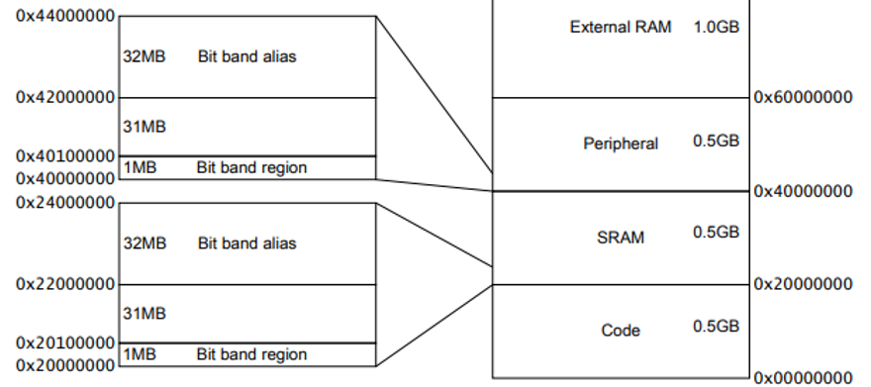
Bit-Banding
Bit-banding is a powerful feature of the ARM Cortex-M4 architecture that allows bit-level access to memory-mapped peripherals and SRAM using regular word-aligned addresses — effectively letting you set or clear individual bits with a single instruction.
Why Use Bit-Banding?
  Avoid read-modify-write race conditions.
  Set or clear individual bits without masking.
  Improves code readability and speed.
  Useful in interrupt handlers and critical sections.

Slide 6
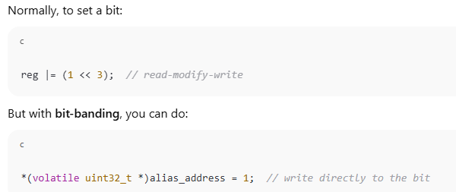
The bit-band mechanism is a feature found in some ARM Cortex-M microcontrollers (like Cortex-M3, M4, and M7), which allows atomic access to individual bits in memory or peripherals.
It essentially maps each individual bit in a region of memory (called the bit-band region) to a unique 32-bit word in another region (called the bit-band alias region).
dedicated alias address
  A special, separate memory address that represents one specific bit of a word in normal memory or peripheral space — mapped by hardware.
  When you read or write to this alias address, the processor automatically accesses the corresponding bit in the original memory, without needing bit-masking or shifting.
The alias address is a 32-bit-wide memory location, but only one bit is affected — the one it maps to in the original memory.

Slide 7
The System bus interface contains logic that controls bit-band accesses as follows:
It remaps bit-band alias addresses to the bit-band region.
For reads, it extracts the requested bit from the read byte, and returns this in the Least Significant Bit (LSB) of the read data returned to the core.
For writes, it converts the write to an atomic read-modify-write operation.
The processor does not stall during bit-band operations unless it attempts to access the System bus while the bit-band operation is being carried out.
The memory map has two 32MB alias regions that map to two 1MB bit-band regions:
Accesses to the 32MB SRAM alias region map to the 1MB SRAM bit-band region.
Accesses to the 32MB peripheral alias region map to the 1MB peripheral bit-band region.

Slide 8
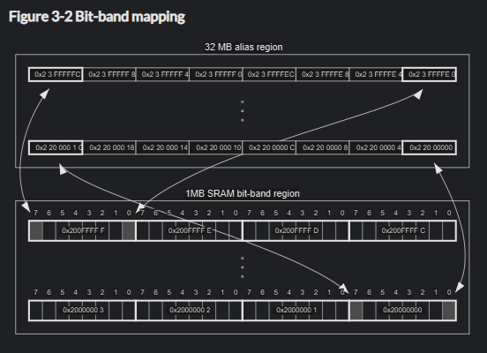
The following figure shows examples of bit-band mapping between the SRAM bit-band alias region and the SRAM bit-band region:

Slide 9
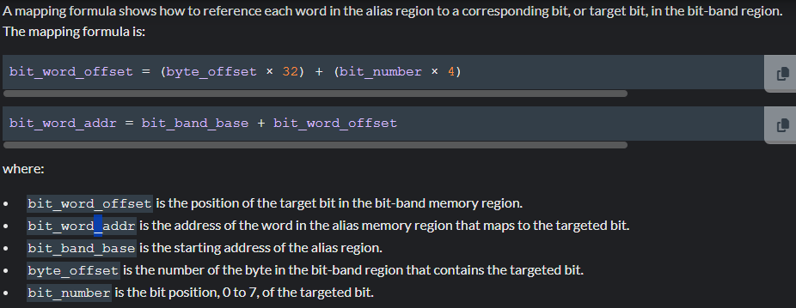

Slide 10
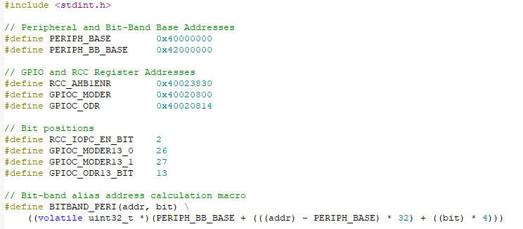
Onboard led blink (pc13)

Slide 11

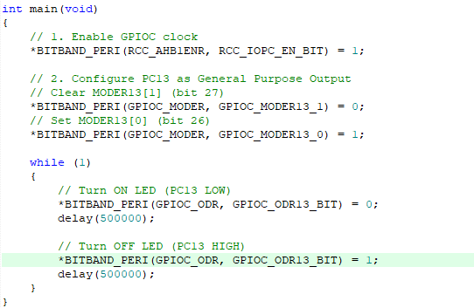

Slide 12

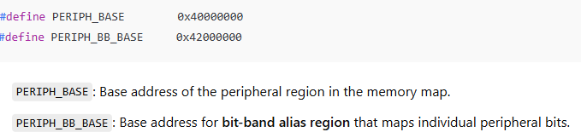

Slide 13
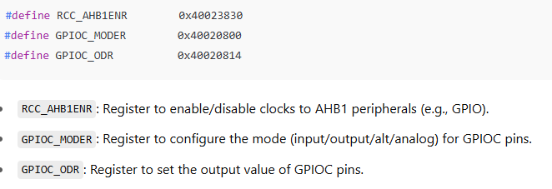
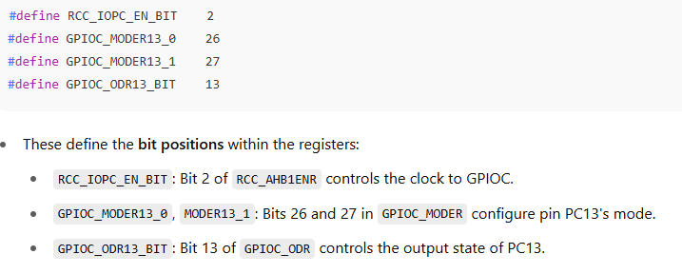

Slide 14

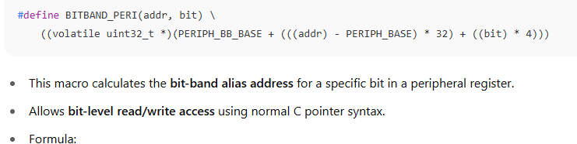
Bit-Band Access Macro
This macro allows you to access a specific bit in a peripheral register using the ARM Cortex-M bit-band alias region.

Slide 15
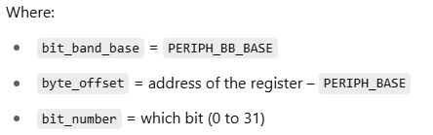
How the Macro Works
bit_word_addr = bit_band_base + ((byte_offset * 32) + (bit_number * 4))
The macro computes a bit-band alias address—a special memory address that lets you read/write just one bit of a memory word (typically a 32-bit register) directly.
The bit-band mechanism is a feature found in some ARM Cortex-M microcontrollers (like Cortex-M3, M4, and M7), which allows atomic access to individual bits in memory or peripherals.
It essentially maps each individual bit in a region of memory (called the bit-band region) to a unique 32-bit word in another region (called the bit-band alias region).

Slide 16
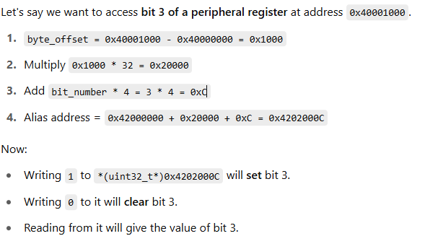
The bit-band alias region is like a huge table where each entry controls one specific bit in memory. It allows:
  Atomic bit manipulation
  Simplified code for setting/clearing individual bits
  No need for masking or read-modify-write
Example
why multiply by 32 and 4?
We want to map each bit in the bit-band region to a unique 32-bit word (4 bytes) in the alias region.

Slide 17
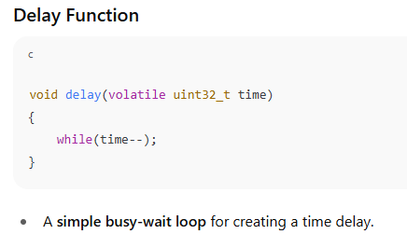
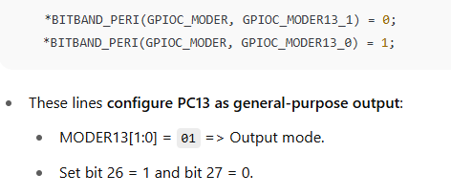
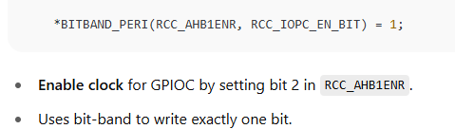

Slide 18
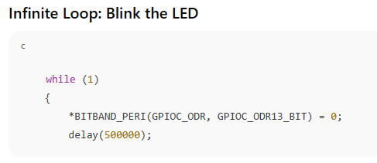
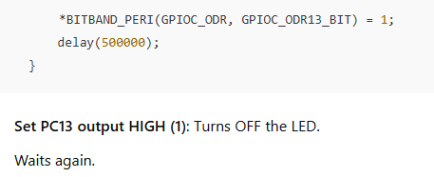
Set PC13 output LOW (0): On STM32 dev boards (like Nucleo), LED is usually active-low, so this turns ON the LED.

